Slide 1
Lecture 1
Digital Systems and Binary Numbers
Digital Systems

Slide 2
Course Topics
Digital Circuit

Slide 3
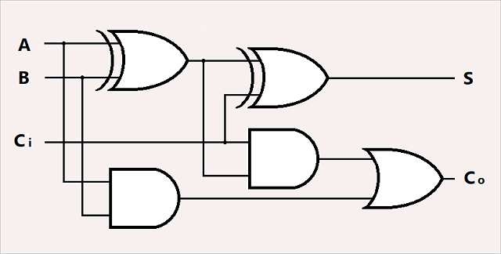
Course Topics
Digital Circuit

Slide 4
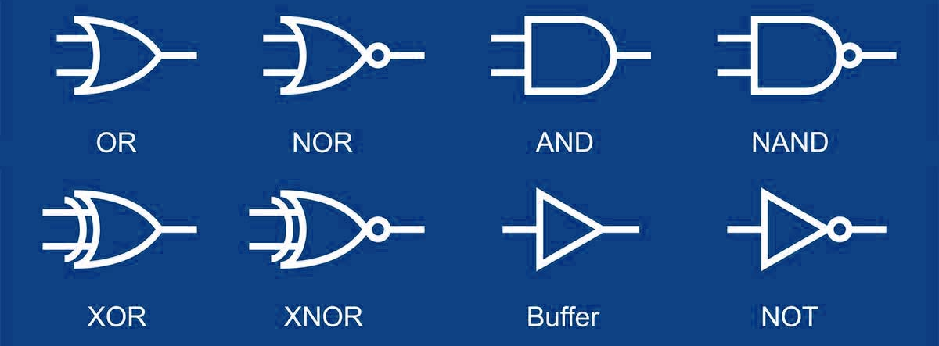
Course Topics
Digital Circuit
Logic Gates

Slide 5
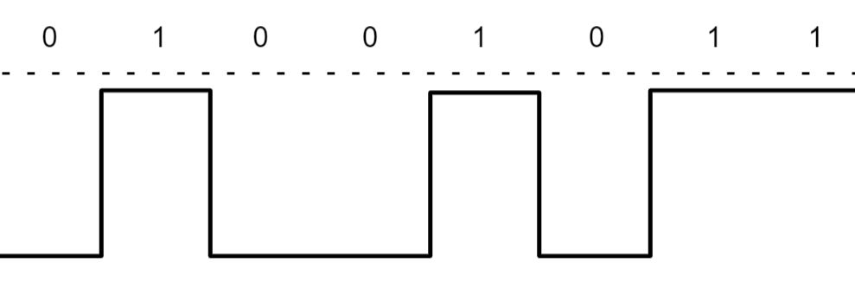
Course Topics
Digital signal
Digital Circuit
Logic Gates

Slide 6
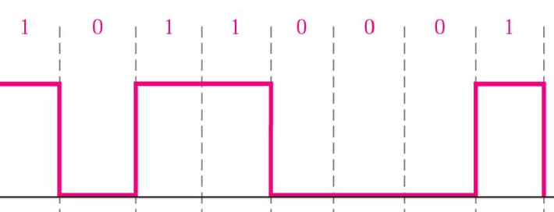
Course Topics
Digital signal
Digital Circuit
Digital signal
Logic Gates

Slide 7
Course Topics
Logic Gates

Slide 8
Course Topics
❶ Binary number system
Logic Gates

Slide 9
Course Topics
❶ Binary number system
Logic Gates
❷ Boolean Algebra

Slide 10
Course Topics
❸ Combinational Circuit Design
❶ Binary number system
Logic Gates
❷ Boolean Algebra

Slide 11
Course Topics
❸ Combinational Circuit Design
❹ Sequential Circuit Design
❶ Binary number system
Logic Gates
❷ Boolean Algebra

Slide 12
Digital Systems and Binary Numbers
Binary Numbers

Slide 13

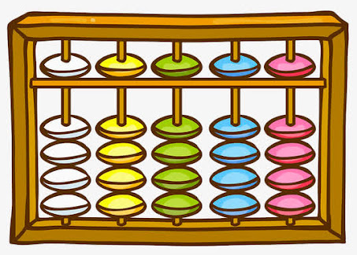
Numbers system
We like to count by decimal number (base-10)
We have 10 fingers

Slide 14
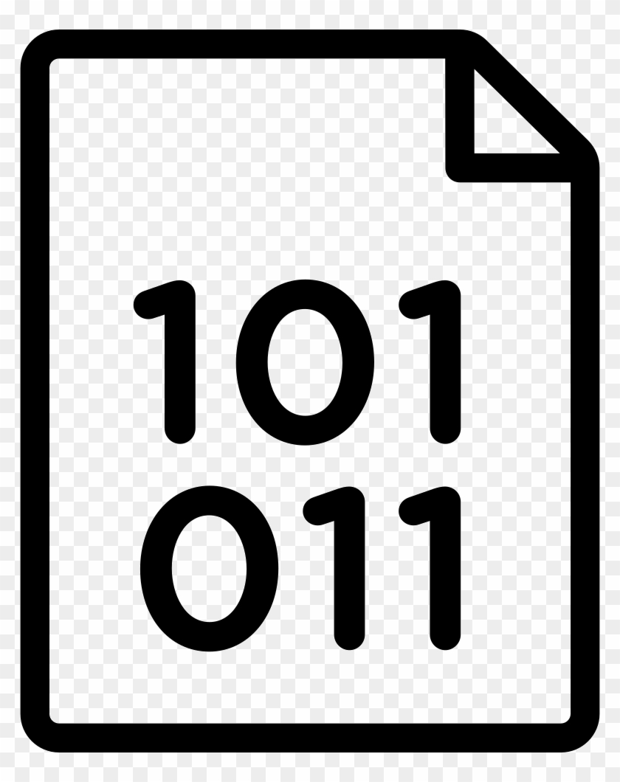


Numbers system
Computer only accept binary number and output binary number

Slide 15
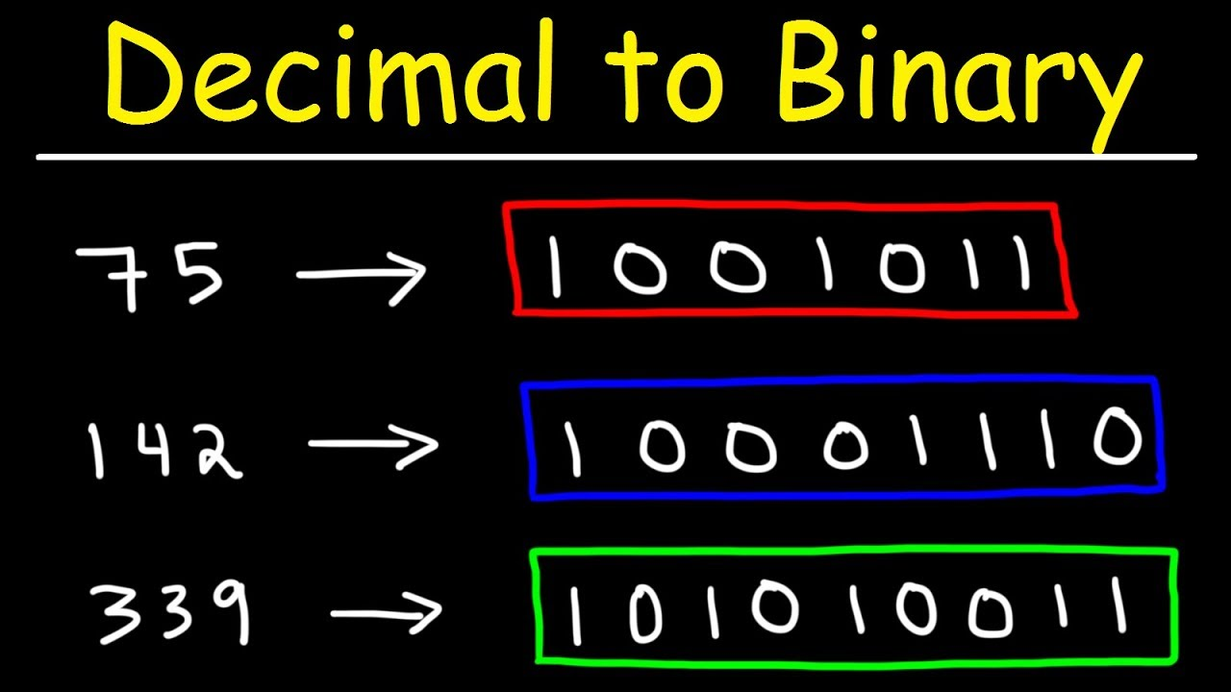
Numbers system

Slide 16
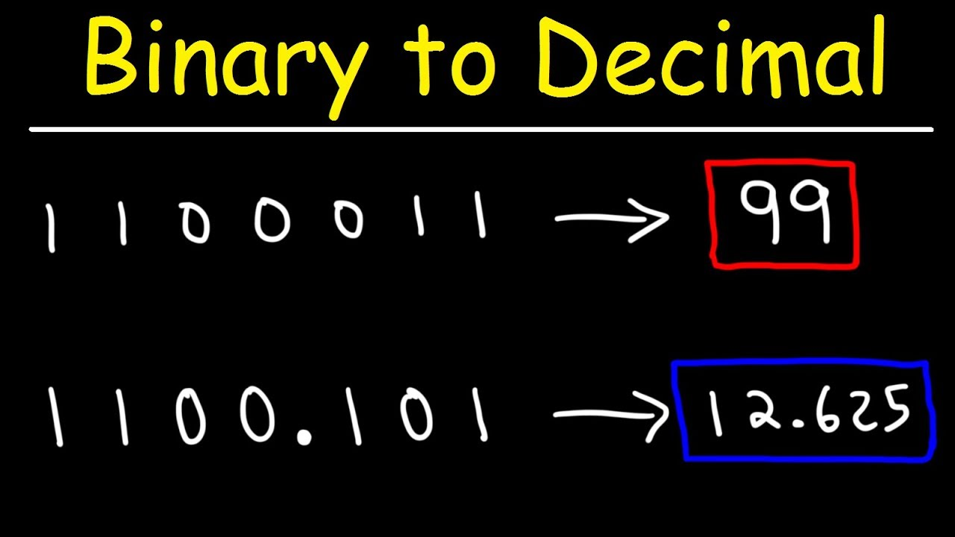
Numbers system

Slide 17
A number can be represented by any number-based system
Decimal
50₁₀
62₈
110010₂
32₁₆
Octal
Binary
Hexadecimal

Slide 18
Numbers of different bases can also be converted to each other
62₈
110010₂
32₁₆
Octal
Binary
Hexadecimal

Slide 19
The conversion will be through decimal
Octal
Binary
Hexadecimal
62₈
110010₂
32₁₆
50₁₀
Decimal

Slide 20
Binary Numbers
Non-Decimal to Decimal

Slide 21
Non-Decimal to Decimal
Decimal number
Weight-&-coefficient expression
Weight
10³ | 10² | 10¹ | 10⁰
5 | 3 | 1 | 9
coefficient
5 × 10³ + 3 × 10² + 1 × 10¹ + 9 × 10⁰
9 × 10⁰ = 9 × 1 = 9
1 × 10¹ = 1 × 10 = 10
3 × 10² = 3 × 100 = 300
5 × 10³ = 5 × 1000 = 5000
5319₁₀

Slide 22
Non-Decimal to Decimal
8² | 8¹ | 8⁰
2 | 3 | 5
Example 1
Octal number: 235₈

Slide 23
Non-Decimal to Decimal
Expand
8² | 8¹ | 8⁰
2 | 3 | 5
Example 1
Octal number: 235₈

Slide 24
Non-Decimal to Decimal
Expand
8² | 8¹ | 8⁰
2 | 3 | 5
2 × 8² + 3 × 8¹ + 5 × 8⁰
Example 1
Octal number: 235₈

Slide 25
Non-Decimal to Decimal
Expand
Multiplication (by base-10)
8² | 8¹ | 8⁰
2 | 3 | 5
2 × 8² + 3 × 8¹ + 5 × 8⁰
Example 1
Octal number: 235₈

Slide 26
Non-Decimal to Decimal
Expand
Multiplication (by base-10)
8² | 8¹ | 8⁰
2 | 3 | 5
2 × 8² + 3 × 8¹ + 5 × 8⁰
128 + 24 + 5
Example 1
Octal number: 235₈

Slide 27
Non-Decimal to Decimal
Expand
Multiplication (by base-10)
Addition (by base-10)
8² | 8¹ | 8⁰
2 | 3 | 5
2 × 8² + 3 × 8¹ + 5 × 8⁰
128 + 24 + 5
Example 1
Octal number: 235₈

Slide 28
Non-Decimal to Decimal
Expand
Multiplication (by base-10)
Addition (by base-10)
8² | 8¹ | 8⁰
2 | 3 | 5
2 × 8² + 3 × 8¹ + 5 × 8⁰
128 + 24 + 5
157₁₀
Example 1
Octal number: 235₈

Slide 29
Non-Decimal to Decimal
2⁵ | 2⁴ | 2³ | 2² | 2¹ | 2⁰
1 | 0 | 1 | 1 | 0 | 1
Example 2
Binary number: 101101₂

Slide 30
Non-Decimal to Decimal
Expand
2⁵ | 2⁴ | 2³ | 2² | 2¹ | 2⁰
1 | 0 | 1 | 1 | 0 | 1
Example 2
Binary number: 101101₂

Slide 31
Non-Decimal to Decimal
Expand
2⁵ | 2⁴ | 2³ | 2² | 2¹ | 2⁰
1 | 0 | 1 | 1 | 0 | 1
1×2⁵+0×2⁴+1×2³+1×2²+0×2¹+1×2⁰
Example 2
Binary number: 101101₂

Slide 32
Non-Decimal to Decimal
Expand
Multiplication (by base-10)
2⁵ | 2⁴ | 2³ | 2² | 2¹ | 2⁰
1 | 0 | 1 | 1 | 0 | 1
1×2⁵+0×2⁴+1×2³+1×2²+0×2¹+1×2⁰
Example 2
Binary number: 101101₂

Slide 33
Non-Decimal to Decimal
Expand
Multiplication (by base-10)
2⁵ | 2⁴ | 2³ | 2² | 2¹ | 2⁰
1 | 0 | 1 | 1 | 0 | 1
1×2⁵+0×2⁴+1×2³+1×2²+0×2¹+1×2⁰
32 + 8 + 4 + 1
Example 2
Binary number: 101101₂

Slide 34
Non-Decimal to Decimal
Expand
Multiplication (by base-10)
Addition (by base-10)
2⁵ | 2⁴ | 2³ | 2² | 2¹ | 2⁰
1 | 0 | 1 | 1 | 0 | 1
1×2⁵+0×2⁴+1×2³+1×2²+0×2¹+1×2⁰
32 + 8 + 4 + 1
Example 2
Binary number: 101101₂

Slide 35
Non-Decimal to Decimal
Expand
Multiplication (by base-10)
Addition (by base-10)
2⁵ | 2⁴ | 2³ | 2² | 2¹ | 2⁰
1 | 0 | 1 | 1 | 0 | 1
1×2⁵+0×2⁴+1×2³+1×2²+0×2¹+1×2⁰
32 + 8 + 4 + 1
45₁₀
Example 2
Binary number: 101101₂

Slide 36
Exercise_1
110101₂ = 1 × 2⁵ + 1 × 2⁴ + 0 × 2³ + 1 × 2² + 0 × 2¹ + 1 × 2⁰
= 1 × 2⁵ + 1 × 2⁴ + 1 × 2² + 1 × 2⁰
= 32 + 16 + 4 + 1
= 53₁₀

Slide 37
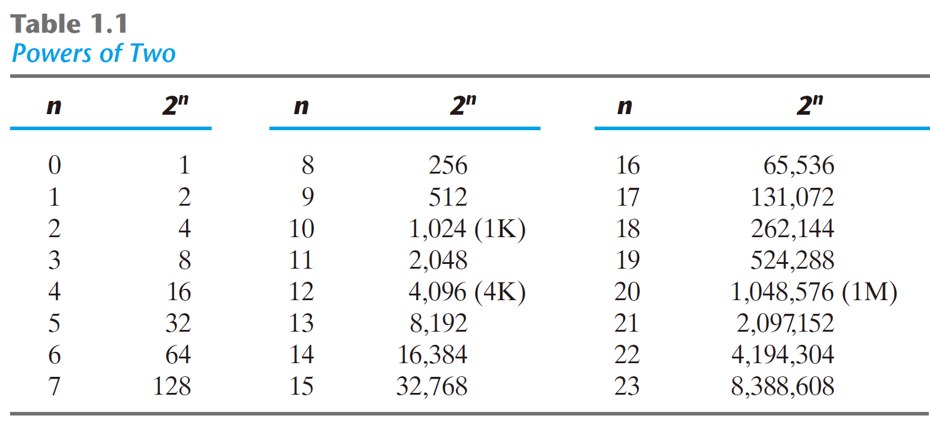

Slide 38
Special Powers of 2
2¹⁰ (1024) is Kilo, denoted "K"
2²⁰ (1,048,576) is Mega, denoted "M"
2³⁰ (1,073, 741,824) is Giga, denoted "G"

Slide 39
Exercise_2
What is the decimal value of
1 × 2⁴ + 0 × 2³ + 1 × 2² + 0 × 2¹ + 1 × 2⁰ ?
Answer: 21

Slide 40
Exercise_3
4021₅ = 4 × 5³ + 0 × 5² + 2 × 5¹ + 1 × 5⁰
= 500 + 10 + 1
= 511₁₀

Slide 41
Exercise_4
127₈ = 1 × 8² + 2 × 8¹ + 7 × 8⁰
= 64 + 16 + 7
= 87₁₀

Slide 42
Exercise_5
B65F₁₆ = 11 × 16³ + 6 × 16² + 5 × 16¹ + 15 × 16⁰
= 45056 + 1536 + 80 + 15
= 46687₁₀

Slide 43
Hexadecimal | Decimal
0 | 0
1 | 1
2 | 2
3 | 3
4 | 4
5 | 5
6 | 6
7 | 7
Hexadecimal | Decimal
8 | 8
9 | 9
A | 10
B | 11
C | 12
D | 13
E | 14
F | 15

Slide 44
Binary Numbers
Decimal to non-Decimal

Slide 45
Decimal to non-Decimal
Decimal Number
5 | 9 | 8 | 4 | 3 | 2
Example 1

Slide 46
Decimal to non-Decimal
Decimal Number
5 | 9 | 8 | 4 | 3 | 2 | ÷ | 10³
Example 1

Slide 47
Decimal to non-Decimal
Decimal Number
5 | 9 | 8 | 4 | 3 | 2 | ÷ | 10³
5 | 9 | 8 | 4 | 3 | 2
Quotient
Example 1

Slide 48
Decimal to non-Decimal
Decimal Number
5 | 9 | 8 | 4 | 3 | 2 | ÷ | 10³
5 | 9 | 8 | 4 | 3 | 2
Remainder
Example 1

Slide 49
Decimal to non-Decimal
Octal Number
5 | 6 | 3 | 4 | 7 | 1
Example 2

Slide 50
Decimal to non-Decimal
Octal Number
5 | 6 | 3 | 4 | 7 | 1 | ÷ | 8⁵
Example 2

Slide 51
Decimal to non-Decimal
Octal Number
5 | 6 | 3 | 4 | 7 | 1 | ÷ | 8⁵
5 | 6 | 3 | 4 | 7 | 1
Quotient
Example 2

Slide 52
Decimal to non-Decimal
Octal Number
5 | 6 | 3 | 4 | 7 | 1 | ÷ | 8⁵
5 | 6 | 3 | 4 | 7 | 1
Remainder
Example 2

Slide 53
Decimal to non-Decimal
Decimal
Octal

Slide 54
Decimal to non-Decimal
Decimal
Octal
157

Slide 55
Decimal to non-Decimal
Decimal
Octal
157
=
a_{n-1} | a_{n-2} | … | a₂ | a₁ | a₀

Slide 56
Decimal to non-Decimal
Decimal
Octal
157
=
a_{n-1} | a_{n-2} | … | a₂ | a₁ | a₀
a_{n-1} | a_{n-2} | … | a₂ | a₁ | a₀

Slide 57
Decimal to non-Decimal
Decimal
Octal
157 | ÷ | 8
=
a_{n-1} | a_{n-2} | … | a₂ | a₁ | a₀ | ÷ | 8
a_{n-1} | a_{n-2} | … | a₂ | a₁ | a₀
Round 1

Slide 58
Decimal to non-Decimal
Decimal
Octal
157 | ÷ | 8
=
a_{n-1} | a_{n-2} | … | a₂ | a₁ | a₀ | ÷ | 8
Q | R
19 | 5
Q |  |  |  |  | R
a_{n-1} | a_{n-2} | … | a₂ | a₁ | a₀
a_{n-1} | a_{n-2} | … | a₂ | a₁ | a₀
Round 1

Slide 59
Decimal to non-Decimal
Decimal
Octal
157 | ÷ | 8
=
a_{n-1} | a_{n-2} | … | a₂ | a₁ | a₀ | ÷ | 8
Q
19
Q
a_{n-1} | a_{n-2} | … | a₂ | a₁
=
a_{n-1} | a_{n-2} | … | a₂ | a₁ | a₀
Round 1

Slide 60
Decimal to non-Decimal
Decimal
Octal
157 | ÷ | 8
=
a_{n-1} | a_{n-2} | … | a₂ | a₁ | a₀ | ÷ | 8
R
5
R
a₀
=
a_{n-1} | a_{n-2} | … | a₂ | a₁ | a₀
Round 1

Slide 61
Decimal to non-Decimal
Decimal
Octal
157 | ÷ | 8
=
a_{n-1} | a_{n-2} | … | a₂ | a₁ | a₀ | ÷ | 8
R
5
R
a₀
=
a_{n-1} | a_{n-2} | … | a₂ | a₁ | a₀
 |  |  |  |  | 5
Round 1

Slide 62
Decimal to non-Decimal
Decimal
Octal
19
=
a_{n-1} | a_{n-2} | … | a₂ | a₁
a_{n-1} | a_{n-2} | … | a₂ | a₁ | a₀
 |  |  |  |  | 5
Round 2

Slide 63
Decimal to non-Decimal
Decimal
Octal
19 | ÷ | 8
=
a_{n-1} | a_{n-2} | … | a₂ | a₁ |  | ÷ | 8
a_{n-1} | a_{n-2} | … | a₂ | a₁ | a₀
 |  |  |  |  | 5
Round 2

Slide 64
Decimal to non-Decimal
Decimal
Octal
19 | ÷ | 8
=
a_{n-1} | a_{n-2} | … | a₂ | a₁ |  | ÷ | 8
Q | R
2 | 3
Q |  |  |  | R
a_{n-1} | a_{n-2} | … | a₂ | a₁
a_{n-1} | a_{n-2} | … | a₂ | a₁ | a₀
 |  |  |  |  | 5
Round 2

Slide 65
Decimal to non-Decimal
Decimal
Octal
19 | ÷ | 8
=
a_{n-1} | a_{n-2} | … | a₂ | a₁ |  | ÷ | 8
Q
2
Q
a_{n-1} | a_{n-2} | … | a₂
=
a_{n-1} | a_{n-2} | … | a₂ | a₁ | a₀
 |  |  |  |  | 5
Round 2

Slide 66
Decimal to non-Decimal
Decimal
Octal
19 | ÷ | 8
=
a_{n-1} | a_{n-2} | … | a₂ | a₁ |  | ÷ | 8
 | R
 | 3
 |  |  |  | R
 |  |  |  | a₁
=
a_{n-1} | a_{n-2} | … | a₂ | a₁ | a₀
 |  |  |  |  | 5
Round 2

Slide 67
Decimal to non-Decimal
Decimal
Octal
19 | ÷ | 8
=
a_{n-1} | a_{n-2} | … | a₂ | a₁ |  | ÷ | 8
 | R
 | 3
 |  |  |  | R
 |  |  |  | a₁
=
a_{n-1} | a_{n-2} | … | a₂ | a₁ | a₀
 |  |  |  | 3 | 5
Round 2

Slide 68
Decimal to non-Decimal
Decimal
Octal
2
=
a_{n-1} | a_{n-2} | … | a₂
a_{n-1} | a_{n-2} | … | a₂ | a₁ | a₀
 |  |  |  | 3 | 5
Round 3

Slide 69
Decimal to non-Decimal
Decimal
Octal
2 | ÷ | 8
=
a_{n-1} | a_{n-2} | … | a₂ |  |  | ÷ | 8
a_{n-1} | a_{n-2} | … | a₂ | a₁ | a₀
 |  |  |  | 3 | 5
Round 3

Slide 70
Decimal to non-Decimal
Decimal
Octal
2 | ÷ | 8
=
a_{n-1} | a_{n-2} | … | a₂ |  |  | ÷ | 8
Q | R
0 | 2
Q |  |  | R
a_{n-1} | a_{n-2} | … | a₂
a_{n-1} | a_{n-2} | … | a₂ | a₁ | a₀
 |  |  |  | 3 | 5
Round 3

Slide 71
Decimal to non-Decimal
Decimal
Octal
19 | ÷ | 8
=
a_{n-1} | a_{n-2} | … | a₂ | a₁ |  | ÷ | 8
Q
0
Q
a_{n-1} | a_{n-2} | …
=
a_{n-1} | a_{n-2} | … | a₂ | a₁ | a₀
 |  |  |  | 3 | 5
Round 3

Slide 72
Decimal to non-Decimal
Decimal
Octal
19 | ÷ | 8
=
a_{n-1} | a_{n-2} | … | a₂ | a₁ |  | ÷ | 8
Q
0
Q
a_{n-1} | a_{n-2} | …
=
 |  |  | a₂ | a₁ | a₀
 |  |  |  | 3 | 5
Round 3

Slide 73
Decimal to non-Decimal
Decimal
Octal
19 | ÷ | 8
=
a_{n-1} | a_{n-2} | … | a₂ | a₁ |  | ÷ | 8
 | R
 | 2
 |  |  | R
 |  |  | a₂
=
 |  |  | a₂ | a₁ | a₀
 |  |  |  | 3 | 5
Round 3

Slide 74
Decimal to non-Decimal
Decimal
Octal
19 | ÷ | 8
=
a_{n-1} | a_{n-2} | … | a₂ | a₁ |  | ÷ | 8
 | R
 | 2
 |  |  | R
 |  |  | a₂
=
 |  |  | a₂ | a₁ | a₀
 |  |  | 2 | 3 | 5
Round 3

Slide 75
Decimal to non-Decimal
157₁₀ = 235₈

Slide 76
Decimal to non-Decimal
 |  | 157₁₀

Slide 77
Decimal to non-Decimal
Round1 | 8 | 157₁₀

Slide 78
Decimal to non-Decimal
Round1 | 8 | 157₁₀
 |  |  | 19 |  | 5

Slide 79
Decimal to non-Decimal
Round1 | 8 | 157₁₀ |  |  | R
 |  |  | 19 |  | 5 | a0

Slide 80
Decimal to non-Decimal
Round1 | 8 | 157₁₀ |  |  | R
Round2 | 8 |  | 19 |  | 5 | a0

Slide 81
Decimal to non-Decimal
Round1 | 8 | 157₁₀ |  |  | R
Round2 | 8 |  | 19 |  | 5 | a0
 |  |  |  | 2 | 3

Slide 82
Decimal to non-Decimal
Round1 | 8 | 157₁₀ |  |  | R
Round2 | 8 |  | 19 |  | 5 | a0
 |  |  |  | 2 | 3 | a1

Slide 83
Decimal to non-Decimal
Round1 | 8 | 157₁₀ |  |  | R
Round2 | 8 |  | 19 |  | 5 | a0
Round3 | 8 |  |  | 2 | 3 | a1

Slide 84
Decimal to non-Decimal
Round1 | 8 | 157₁₀ |  |  | R
Round2 | 8 |  | 19 |  | 5 | a0
Round3 | 8 |  |  | 2 | 3 | a1
 |  | 0 |  |  | 2

Slide 85
Decimal to non-Decimal
Round1 | 8 | 157₁₀ |  |  | R
Round2 | 8 |  | 19 |  | 5 | a0
Round3 | 8 |  |  | 2 | 3 | a1
 |  | 0 |  |  | 2 | a2

Slide 86
Decimal to non-Decimal
Round1 | 8 | 157₁₀
Round2 | 8 |  | 19 |  | 5 | a0
Round3 | 8 |  |  | 2 | 3 | a1
 |  | 0 |  |  | 2 | a2
= 235₈

Slide 87
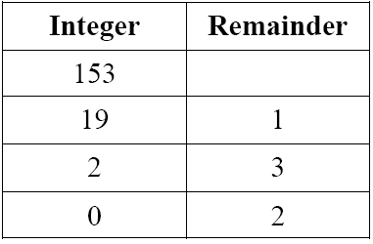
Exercise_1
Convert decimal 153 to octal.
153₁₀ = 231₈

Slide 88
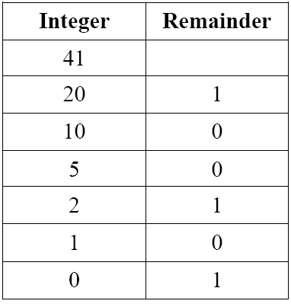
Exercise_2
Convert decimal 41 to binary.
41₁₀ = 101001₂

Slide 89
Binary Numbers
Binary/octal/hexadecimal

Slide 90
Binary-octal-hexadecimal Conversion
Octal | Binary
0 | 000
1 | 001
2 | 010
3 | 011
4 | 100
5 | 101
6 | 110
7 | 111

Slide 91
Binary-octal-hexadecimal Conversion
Hexadecimal | Binary
0 | 0000
1 | 0001
2 | 0010
3 | 0011
4 | 0100
5 | 0101
6 | 0110
7 | 0111
Hexadecimal | Binary
8 | 1000
9 | 1001
A | 1010
B | 1011
C | 1100
D | 1101
E | 1110
F | 1111

Slide 92
Binary to octal
Conversion from binary to octal can be done by positioning the binary number into groups of three digits each, starting from the most right bit.
10110001101011111100000110₂ = ( )₈

Slide 93
Binary to octal
Conversion from binary to octal can be done by positioning the binary number into groups of three digits each, starting from the most right bit.
10 | 110 | 001 | 101 | 011 | 111 | 100 | 000 | 110

Slide 94
Binary to octal
Conversion from binary to octal can be done by positioning the binary number into groups of three digits each, starting from the most right bit.
10 | 110 | 001 | 101 | 011 | 111 | 100 | 000 | 110
2 | 6 | 1 | 5 | 3 | 7 | 4 | 0 | 6

Slide 95
Binary to octal
Conversion from binary to octal can be done by positioning the binary number into groups of three digits each, starting from the most right bit.
10110001101011111100000110₂ = 261537406₈

Slide 96
Octal to binary
Conversion from octal to binary is done by reversing the preceding procedure.
673124₈ = (110 111 011 001 010 100)₂

Slide 97
Octal to binary
Conversion from octal to binary is done by reversing the preceding procedure.
673124₈ = 110 111 011 001 010 100₂

Slide 98
Binary to hexadecimal
Conversion from binary to hexadecimal is similar, except that the binary number is divided into groups of four digits.
10110001101011111100000110₂ = ( )₁₆

Slide 99
Binary to hexadecimal
Conversion from binary to hexadecimal is similar, except that the binary number is divided into groups of four digits.
10 | 1100 | 0110 | 1011 | 1111 | 0000 | 0110

Slide 100
Binary to hexadecimal
Conversion from binary to hexadecimal is similar, except that the binary number is divided into groups of four digits.
10 | 1100 | 0110 | 1011 | 1111 | 0000 | 0110
2 | C | 6 | B | F | 0 | 6

Slide 101
Binary to hexadecimal
Conversion from binary to hexadecimal is similar, except that the binary number is divided into groups of four digits.
10110001101011111100000110₂ = 2C6BF06₁₆

Slide 102
hexadecimal to Binary
Conversion from hexadecimal to binary is done by reversing the preceding procedure.
5AC306D₁₆ = (0101 1010 1100 0011 0000 0110 1101)₂

Slide 103
hexadecimal to Binary
Conversion from hexadecimal to binary is done by reversing the preceding procedure.
5AC306D₁₆ = 0101 1010 1100 0011 0000 0110 1101₂

Slide 104
Octal to hexadecimal
It is a smart choice through binary
261537406₈ = ( )₁₆

Slide 105
Octal to hexadecimal
It is a smart choice through binary
261537406₈ = ( )₁₆
10 110 001 101 011 111 100 000 110₂

Slide 106
Octal to hexadecimal
It is a smart choice through binary
261537406₈ = ( )₁₆
10110001101011111100000110₂

Slide 107
Octal to hexadecimal
It is a smart choice through binary
261537406₈ = ( )₁₆
10 1100 0110 1011 1111 0000 0110₂

Slide 108
Octal to hexadecimal
It is a smart choice through binary
261537406₈ = ( 2C6BF06 )₁₆
10 1100 0110 1011 1111 0000 0110₂

Slide 109
Hexadecimal to octal
It is a smart choice through binary
39D8ABFC₁₆ = ( )₈

Slide 110
Hexadecimal to octal
It is a smart choice through binary
39D8ABFC₁₆ = ( )₈
0011 1001 1101 1000 1010 1011 1111 1100₂

Slide 111
Hexadecimal to octal
It is a smart choice through binary
39D8ABFC₁₆ = ( )₈
00111001110110001010101111111100₂

Slide 112
Hexadecimal to octal
It is a smart choice through binary
39D8ABFC₁₆ = ( ) ₈
00 111 001 110 110 001 010 101 111 111 100₂

Slide 113
Hexadecimal to octal
It is a smart choice through binary
39D8ABFC₁₆ = ( 7166125774 )₈
00 111 001 110 110 001 010 101 111 111 100₂

Slide 114
thanks

